Slide 1

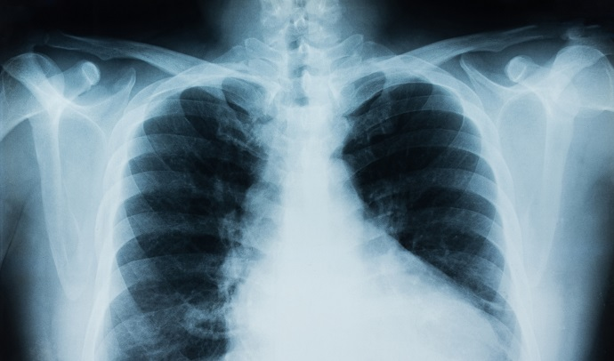
Automated Detection of Pneumonia
By Turki Almuarik & Mozah Alkhaldi

Slide 2
Outline
01
03
04
Introduction & Project Scope
Tools Data & EDA
Image Augmentation
Models
02
05
Conclusion & Future work

Slide 3








Tools

Slide 4
Introduction & Project Scope
What is Pneumonia?
Pneumonia is one of the most common respiratory infections, affecting yearly around 450 million people worldwide. Pneumonia can lead to a serious health effect when left undiagnosed or misdiagnosed.
Goal
Building a model to automatically predict whether a patient is suffering from pneumonia or not by looking at chest X-ray image

Slide 5
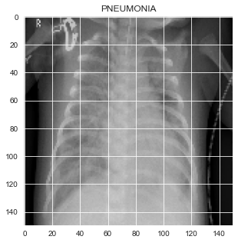
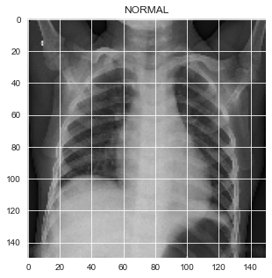
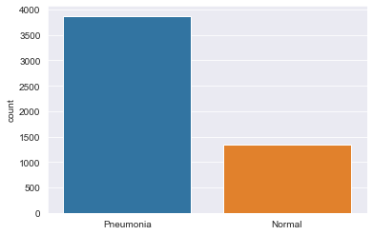
Data & EDA

Slide 6



Image Augmentation
Scale
Rotation
Flip
Skew

Slide 7
PREDICTED RESULTS
Model | Train Accuracy % | Validation Accuracy %
NN | 74.25 | 73.93
CNN Image Augmentation | 96 | 50
CNN | 92 | 50

Slide 8
Graphs
RELATED THESES
RELATED PROJECTS

Slide 9
Conclusion & Future work
We conclude that our NN baseline is the best model with 74% accuracy.
Since the accuracy score is less than accepted in the medical field ,we recommend to use the model only for nonemergency cases.
Increasing the accuracy by designing CNN model on a high computing power PC or cloud services.

Slide 10
Thank You for listening

